Slide 1
PROVIDOR:HOSEIN HEDAYATI
SUPERVISOR:DR.DEHGHANI

Slide 2
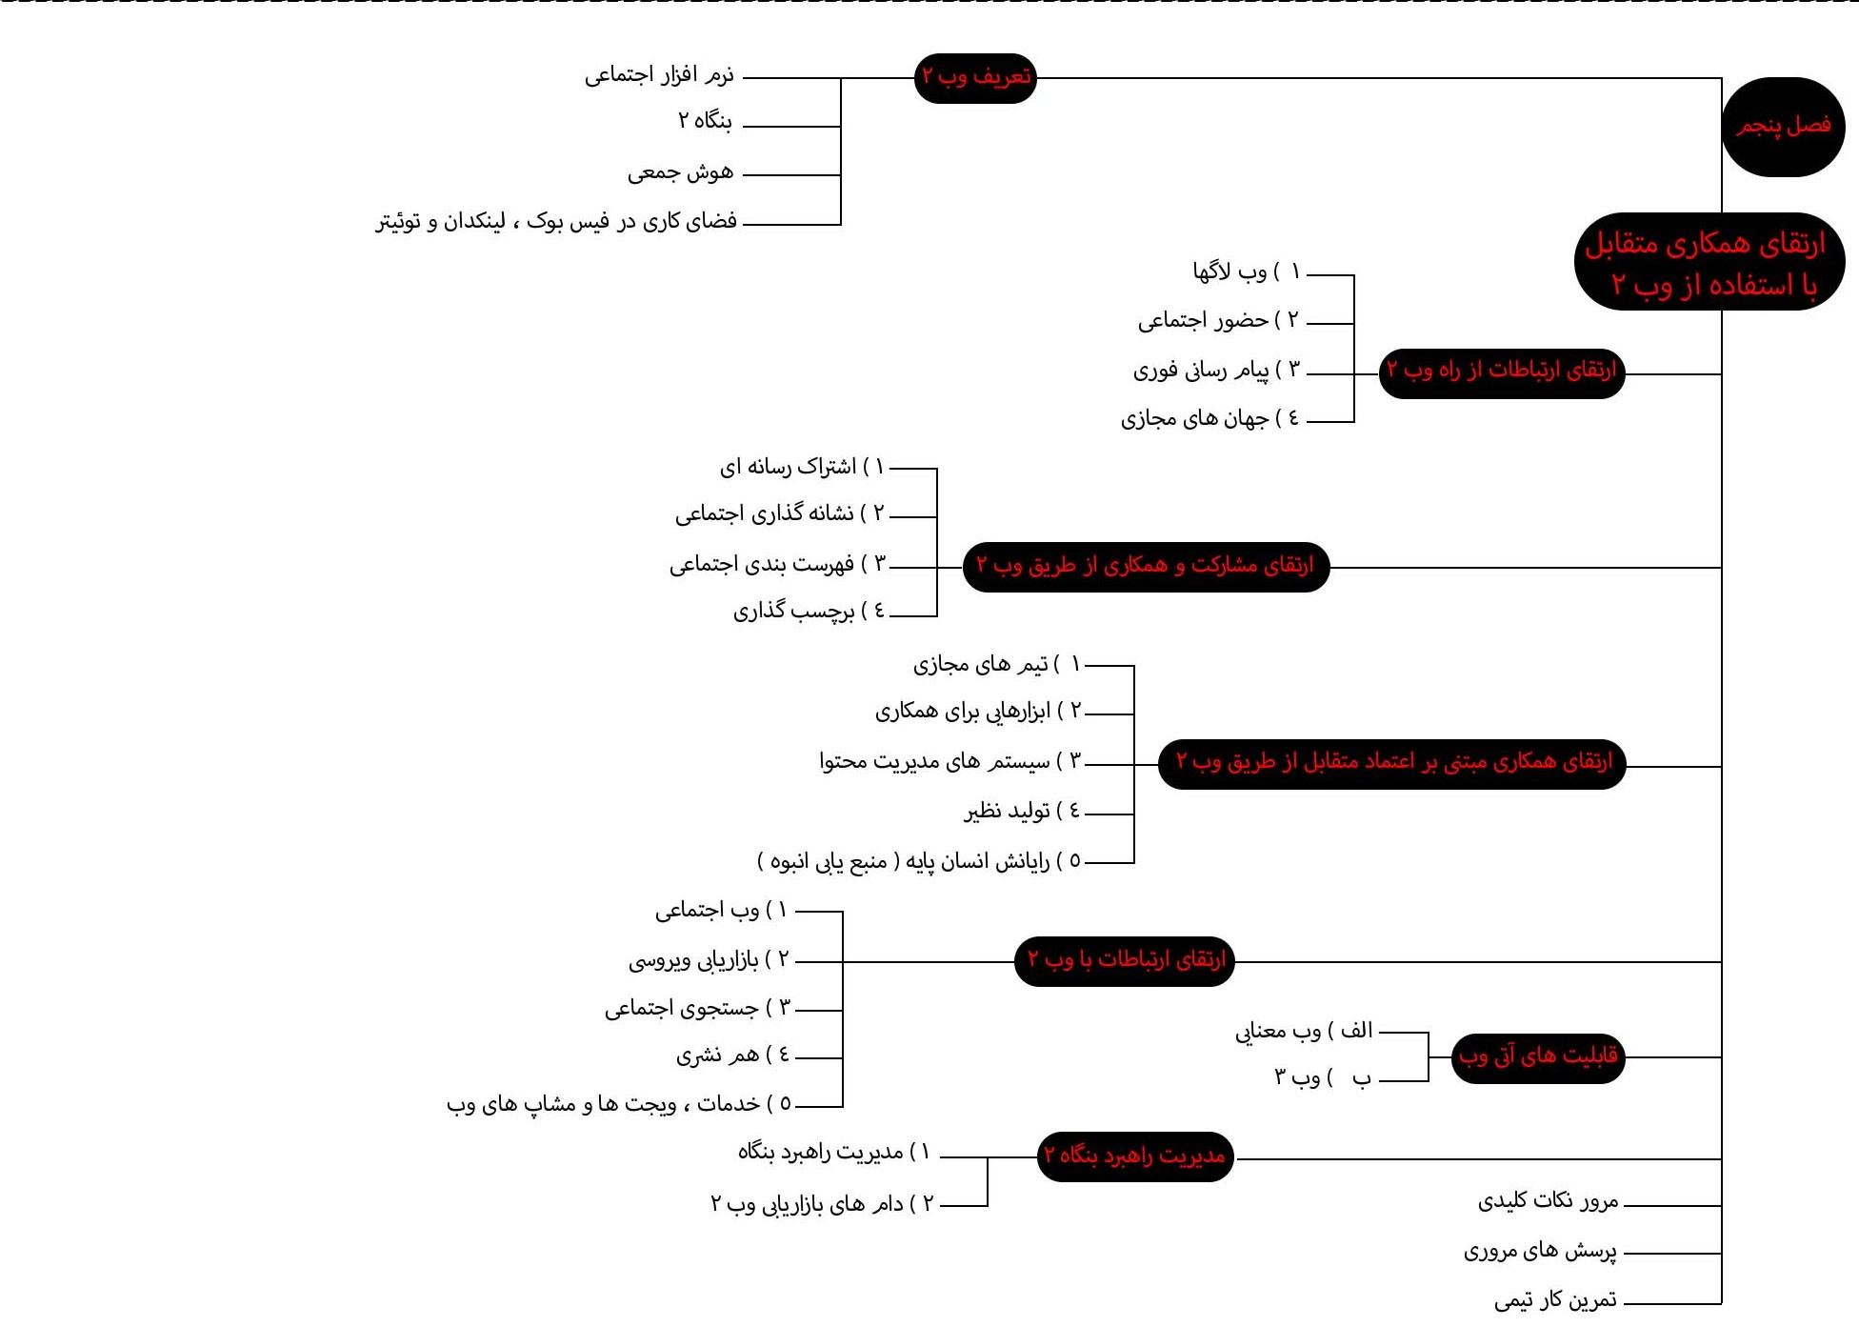
BY:MAHDI ABARGHOUEI ZADEH

Slide 10
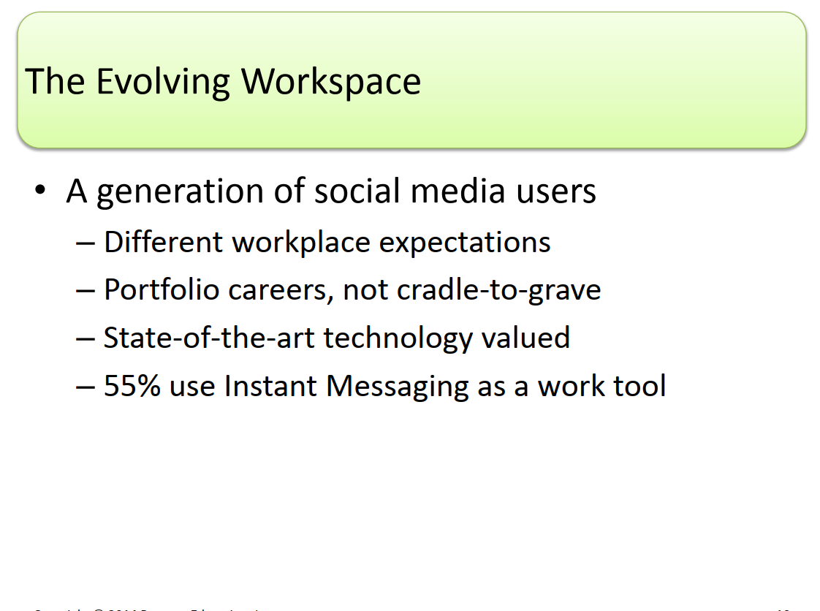

Slide 13
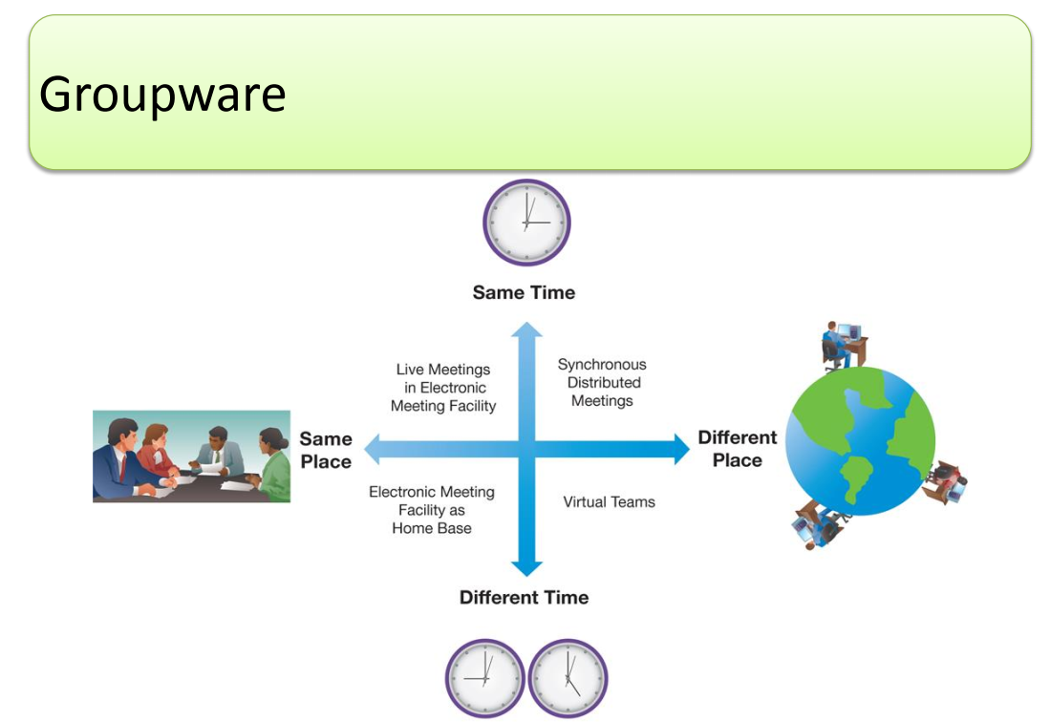

Slide 14
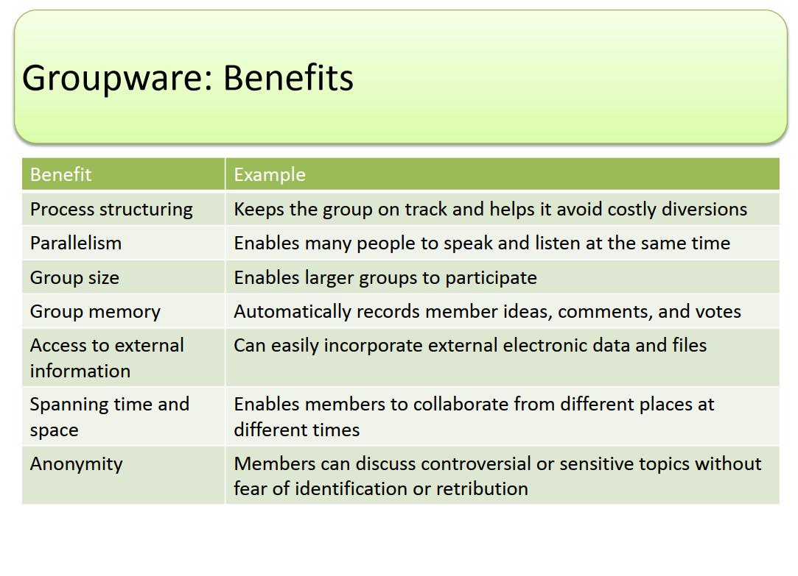

Slide 15
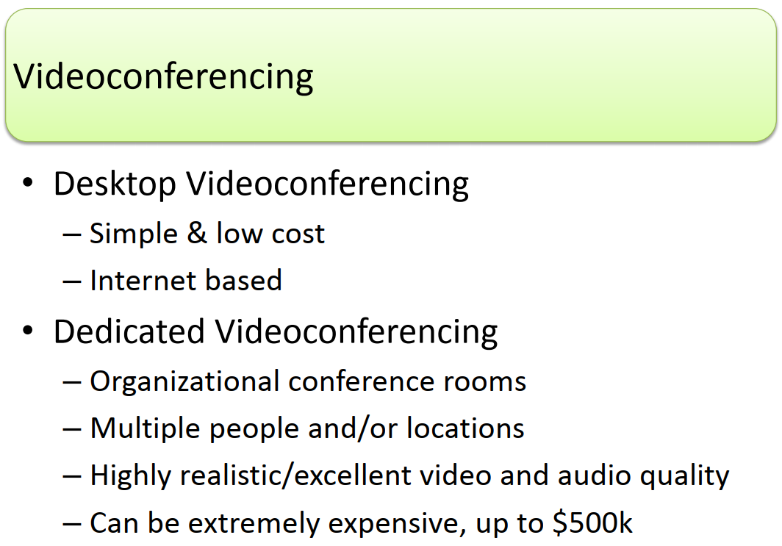

Slide 30
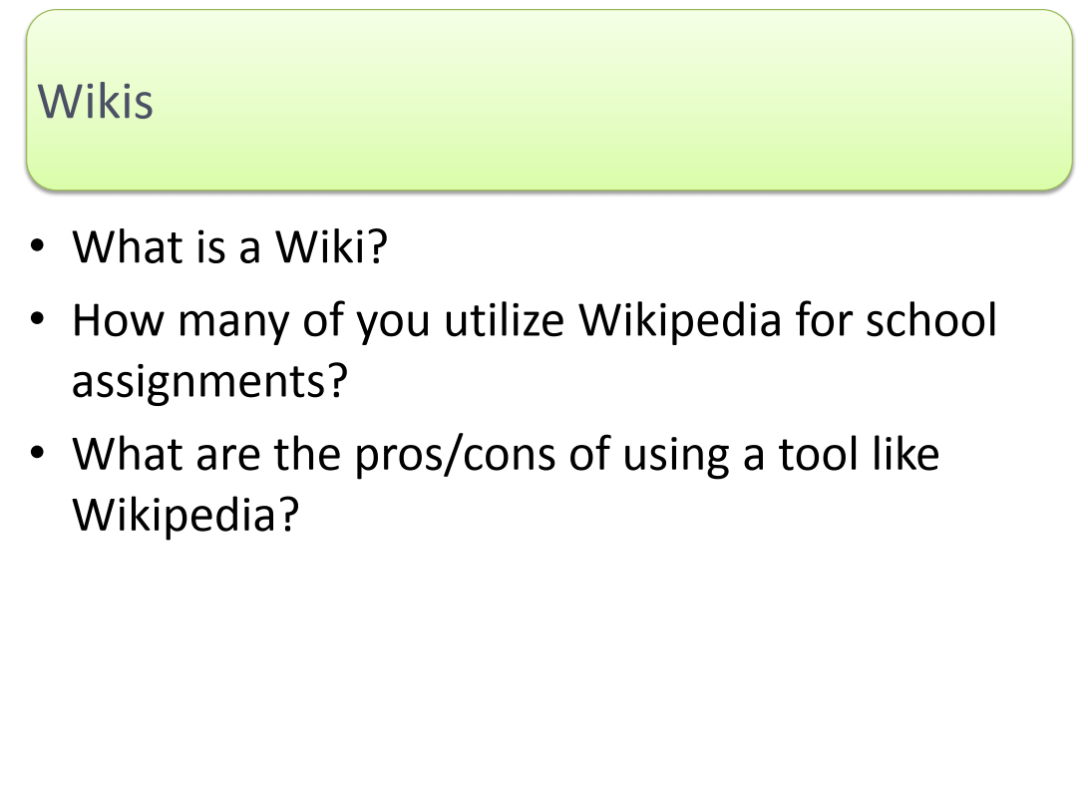

Slide 35
